Slide 1


Boundless Lecture Slides
Available on the Boundless Teaching Platform
Free to share, print, make copies and changes. Get yours at www.boundless.com

Slide 2
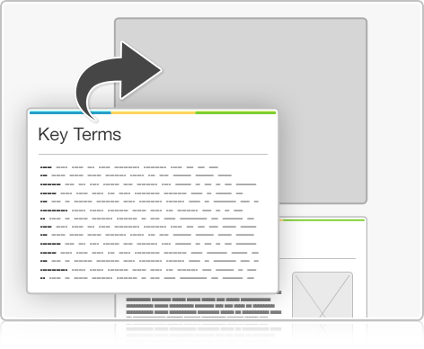


Using Boundless Presentations
Boundless Teaching Platform
Boundless empowers educators to engage their students with affordable, customizable textbooks and intuitive teaching tools. The free Boundless Teaching Platform gives educators the ability to customize textbooks in more than 20 subjects that align to hundreds of popular titles. Get started by using high quality Boundless books, or make switching to our platform easier by building from Boundless content pre-organized to match the assigned textbook. This platform gives educators the tools they need to assign readings and assessments, monitor student activity, and lead their classes with pre-made teaching resources.
Get started now at:
The Appendix
The appendix is for you to use to add depth and breadth to your lectures. You can simply drag and drop slides from the appendix into the main presentation to make for a richer lecture experience.
http://boundless.com/teaching-platform
Free to edit, share, and copy
Feel free to edit, share, and make as many copies of the Boundless presentations as you like. We encourage you to take these presentations and make them your own.
If you have any questions or problems please email:
educators@boundless.com
Free to share, print, make copies and changes. Get yours at www.boundless.com

Slide 3

About Boundless
Boundless is an innovative technology company making education more affordable and accessible for students everywhere. The company creates the world’s best open educational content in 20+ subjects that align to more than 1,000 popular college textbooks. Boundless integrates learning technology into all its premium books to help students study more efficiently at a fraction of the cost of traditional textbooks. The company also empowers educators to engage their students more effectively through customizable books and intuitive teaching tools as part of the Boundless Teaching Platform. More than 2 million learners access Boundless free and premium content each month across the company’s wide distribution platforms, including its website, iOS apps, Kindle books, and iBooks. To get started learning or teaching with Boundless, visit boundless.com.
Free to share, print, make copies and changes. Get yours at www.boundless.com

Slide 4
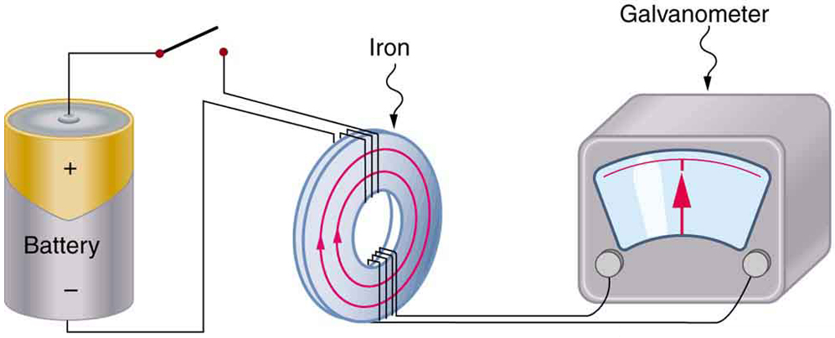
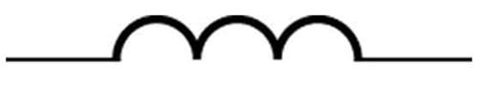
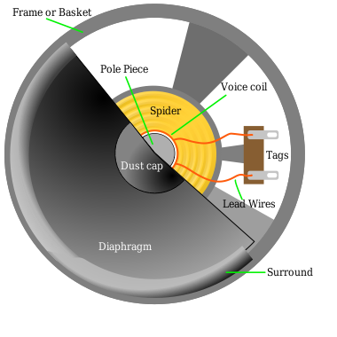
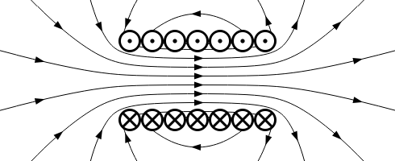

Induction, AC Circuits, and Electrical Technologies
Magnetic Flux, Induction, and Faraday's Law
AC Circuits
Applications of Induction and EM Waves
Magnetic Fields and Maxwell Revisited
]
Induction, AC Circuits, and Electrical Technolo...
Free to share, print, make copies and changes. Get yours at www.boundless.com

Slide 5

Magnetic Flux, Induction, and Faraday's Law
Induction, AC Circuits, and Electrical Technolo... > Magnetic Flux, Induction, and Faraday's Law
Induced EMF and Magnetic Flux
Faraday's Law of Induction and Lenz' Law
Motional EMF
Back EMF, Eddy Currents, and Magnetic Damping
Changing Magnetic Flux Produces an Electric Field
Electric Generators
Electric Motors
Inductance
A Quantitative Interpretation of Motional EMF
Mechanical Work and Electrical Energy
Energy in a Magnetic Field
Transformers
Free to share, print, make copies and changes. Get yours at www.boundless.com
www.boundless.com/physics/textbooks/boundless-physics-textbook/induction-ac-circuits-and-electrical-technologies-22/magnetic-flux-induction-and-faraday-s-law-161/

Slide 6
AC Circuits
Induction, AC Circuits, and Electrical Technolo... > AC Circuits
Inductance
RL Circuits
RLC Series Circuit: At Large and Small Frequencies; Phasor Diagram
Resistors in AC Circuits
Capacitors in AC Circuits: Capacitive Reactance and Phasor Diagrams
Inductors in AC Circuits: Inductive Reactive and Phasor Diagrams
Resonance in RLC Circuits
Power
Free to share, print, make copies and changes. Get yours at www.boundless.com
www.boundless.com/physics/textbooks/boundless-physics-textbook/induction-ac-circuits-and-electrical-technologies-22/ac-circuits-162/

Slide 7
Applications of Induction and EM Waves
Induction, AC Circuits, and Electrical Technolo... > Applications of Induction and EM Waves
Sound Systems, Computer Memory, Seismograph, GFCI
Antennae
Free to share, print, make copies and changes. Get yours at www.boundless.com
www.boundless.com/physics/textbooks/boundless-physics-textbook/induction-ac-circuits-and-electrical-technologies-22/applications-of-induction-and-em-waves-163/

Slide 8
Magnetic Fields and Maxwell Revisited
Induction, AC Circuits, and Electrical Technolo... > Magnetic Fields and Maxwell Revisited
Energy Stored in a Magnetic Field
Maxwell's Predictions and Hertz' Confirmation
Free to share, print, make copies and changes. Get yours at www.boundless.com
www.boundless.com/physics/textbooks/boundless-physics-textbook/induction-ac-circuits-and-electrical-technologies-22/magnetic-fields-and-maxwell-revisited-164/

Slide 9
Appendix
Free to share, print, make copies and changes. Get yours at www.boundless.com

Slide 10
Key terms
Induction, AC Circuits, and Electrical Technolo...
amplifier An appliance or circuit that increases the strength of a weak electrical signal without changing the other characteristics of the signal.
characteristic time constant Denoted by , in RL circuits it is given by where R is resistance and L is inductance. When a switch is closed, it is the time it takes for the current to decay by a factor of 1/e.
electric field A region of space around a charged particle, or between two voltages; it exerts a force on charged objects in its vicinity.
electromotive force (EMF)—The voltage generated by a battery or by the magnetic force according to Faraday's Law. It is measured in units of volts, not newtons, and thus, is not actually a force.
electromotive force (EMF)—The voltage generated by a battery or by the magnetic force according to Faraday's Law. It is measured in units of volts, not newtons, and thus, is not actually a force.
electromotive force (EMF)—The voltage generated by a battery or by the magnetic force according to Faraday's Law. It is measured in units of volts, not newtons, and thus, is not actually a force.
electromotive force (EMF)—The voltage generated by a battery or by the magnetic force according to Faraday's Law. It is measured in units of volts, not newtons, and thus, is not actually a force.
electromotive force (EMF)—The voltage generated by a battery or by the magnetic force according to Faraday's Law. It is measured in units of volts, not newtons, and thus, is not actually a force.
Faraday’s law of induction A basic law of electromagnetism that predicts how a magnetic field will interact with an electric circuit to produce an electromotive force (EMF).
Faraday’s law of induction A basic law of electromagnetism that predicts how a magnetic field will interact with an electric circuit to produce an electromotive force (EMF).
Faraday’s law of induction A basic law of electromagnetism that predicts how a magnetic field will interact with an electric circuit to produce an electromotive force (EMF).
Faraday’s law of induction A basic law of electromagnetism that predicts how a magnetic field will interact with an electric circuit to produce an electromotive force (EMF).
Free to share, print, make copies and changes. Get yours at www.boundless.com

Slide 11
Induction, AC Circuits, and Electrical Technolo...
ferromagnet Materials that show a permanent magnetic property.
flux The rate of transfer of energy (or another physical quantity) through a given surface, specifically electric flux or magnetic flux.
frame of reference A coordinate system or set of axes within which to measure the position, orientation, and other properties of objects in it.
frequency The quotient of the number of times n a periodic phenomenon occurs over the time t in which it occurs: f = n / t.
galvanometer An analog measuring device, denoted by G, that measures current flow using a needle deflection caused by a magnetic field force acting upon a current-carrying wire.
impedance A measure of the opposition to the flow of an alternating current in a circuit; the aggregation of its resistance, inductive and capacitive reactance. Represented by the symbol Z.
induction The generation of an electric current by a varying magnetic field.
inductor A passive device that introduces inductance into an electrical circuit.
inductor A device or circuit component that exhibits significant self-inductance; a device which stores energy in a magnetic field.
inductor A passive device that introduces inductance into an electrical circuit.
inductor A device or circuit component that exhibits significant self-inductance; a device which stores energy in a magnetic field.
Lenz's law A law of electromagnetic induction that states that an electromotive force, induced in a conductor, is always in such a direction that the current produced would oppose the change that caused it; this law is a form of the law of conservation of energy.
Free to share, print, make copies and changes. Get yours at www.boundless.com

Slide 12
Induction, AC Circuits, and Electrical Technolo...
Lenz's law A law of electromagnetic induction that states that an electromotive force, induced in a conductor, is always in such a direction that the current produced would oppose the change that caused it; this law is a form of the law of conservation of energy.
Lorentz force The force exerted on a charged particle in an electromagnetic field.
magnetic field A condition in the space around a magnet or electric current in which there is a detectable magnetic force, and where two magnetic poles are present.
magnetic field A condition in the space around a magnet or electric current in which there is a detectable magnetic force, and where two magnetic poles are present.
magnetic flux A measure of the strength of a magnetic field in a given area.
magnetic flux A measure of the strength of a magnetic field in a given area.
Maxwell's equations A set of equations describing how electric and magnetic fields are generated and altered by each other and by charges and currents.
motional EMF An EMF (electromotive force) induced by motion relative to a magnetic field.
mutual inductance The ratio of the voltage in a circuit to the change in current in a neighboring circuit.
Ohm's law Ohm's observation is that the direct current flowing in an electrical circuit consisting only of resistances is directly proportional to the voltage applied.
permeability A quantitative measure of the degree of magnetization of a material in the presence of an applied magnetic field (measured in newtons per ampere squared in SI units).
phasor A representation of a complex number in terms of a complex exponential.
Free to share, print, make copies and changes. Get yours at www.boundless.com

Slide 13
Induction, AC Circuits, and Electrical Technolo...
reactance The opposition to the change in flow of current in an alternating current circuit, due to inductance and capacitance; the imaginary part of the impedance.
resonance The increase in the amplitude of an oscillation of a system under the influence of a periodic force whose frequency is close to that of the system's natural frequency.
rms Root mean square: a statistical measure of the magnitude of a varying quantity.
rms Root mean square: a statistical measure of the magnitude of a varying quantity.
rms Root mean square: a statistical measure of the magnitude of a varying quantity.
rms Root mean square: a statistical measure of the magnitude of a varying quantity.
rms Root mean square: a statistical measure of the magnitude of a varying quantity.
self-inductance The ratio of the voltage to the change in current in the same circuit.
solenoid A coil of wire that acts as a magnet when an electric current flows through it.
special relativity A theory that (neglecting the effects of gravity) reconciles the principle of relativity with the observation that the speed of light is constant in all frames of reference.
Stokes' theorem a statement about the integration of differential forms on manifolds, which both simplifies and generalizes several theorems from vector calculus.
torque A rotational or twisting effect of a force; (SI unit newton-meter or Nm; imperial unit foot-pound or ft-lb)
Free to share, print, make copies and changes. Get yours at www.boundless.com

Slide 14
Induction, AC Circuits, and Electrical Technolo...
transformer A static device that transfers electric energy from one circuit to another by magnetic coupling. Their main use is to transfer energy between different voltage levels, which allows choosing most appropriate voltage for power generation, transmission and distribution separately.
transmitter An electronic device that generates and amplifies a carrier wave, modulates it with a meaningful signal derived from speech, music, TV or other sources, and broadcasts the resulting signal from an antenna.
turbine Any of various rotary machines that use the kinetic energy of a continuous stream of fluid (a liquid or a gas) to turn a shaft.
vector area A vector whose magnitude is the area under consideration, and whose direction is perpendicular to the surface area.
vector area A vector whose magnitude is the area under consideration and whose direction is perpendicular to the plane.
wavelength The length of a single cycle of a wave, as measured by the distance between one peak or trough of a wave and the next; it is often designated in physics as λ, and corresponds to the velocity of the wave divided by its frequency.
Free to share, print, make copies and changes. Get yours at www.boundless.com

Slide 15
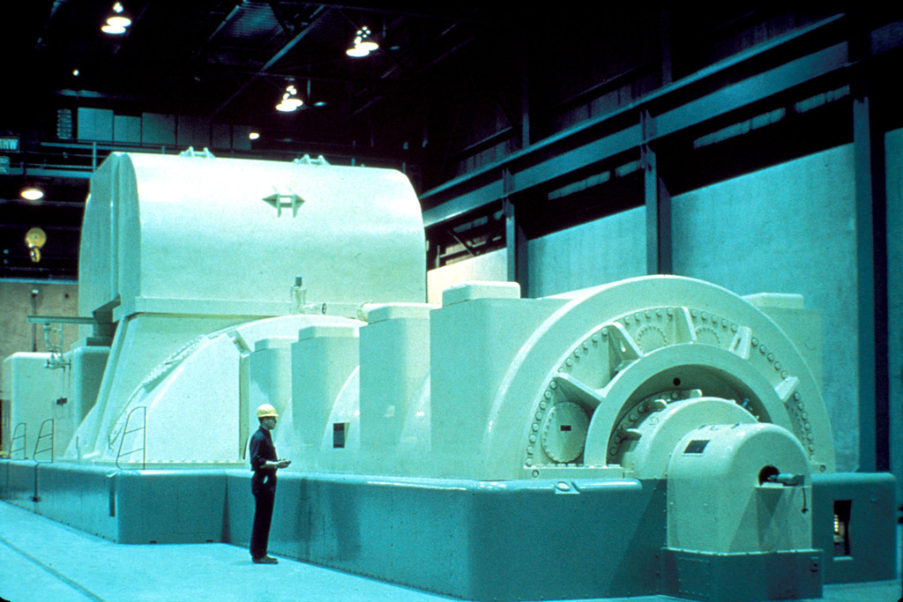

Induction, AC Circuits, and Electrical Technolo...
Steam Turbine Generator
A modern steam turbine generator.
Free to share, print, make copies and changes. Get yours at www.boundless.com
Wikipedia. "Electric generator." CC BY http://en.wikipedia.org/wiki/Electric_generator View on Boundless.com

Slide 16
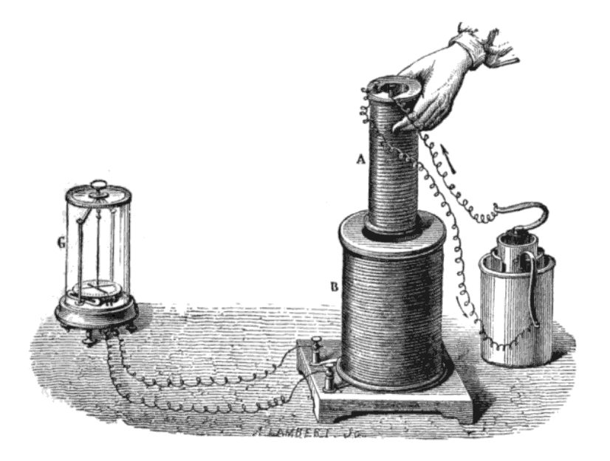
Induction, AC Circuits, and Electrical Technolo...
Faraday's Experiment
Faraday's experiment showing induction between coils of wire: The liquid battery (right) provides a current which flows through the small coil (A), creating a magnetic field. When the coils are stationary, no current is induced. But when the small coil is moved in or out of the large coil (B), the magnetic flux through the large coil changes, inducing a current which is detected by the galvanometer (G).
Free to share, print, make copies and changes. Get yours at www.boundless.com
Wikipedia. "Faraday's law of induction." CC BY http://en.wikipedia.org/wiki/Faraday's_law_of_induction View on Boundless.com

Slide 17
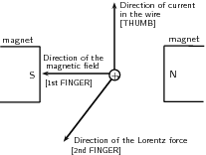
Induction, AC Circuits, and Electrical Technolo...
Right-Hand Rule
Right-hand rule showing the direction of the Lorentz force
Free to share, print, make copies and changes. Get yours at www.boundless.com
OpenStax CNX. "Free High School Science Texts Project, Electrodynamics: Generators and Motors. February 8, 2013." CC BY 3.0 http://cnx.org/content/m39508/latest/ View on Boundless.com

Slide 18
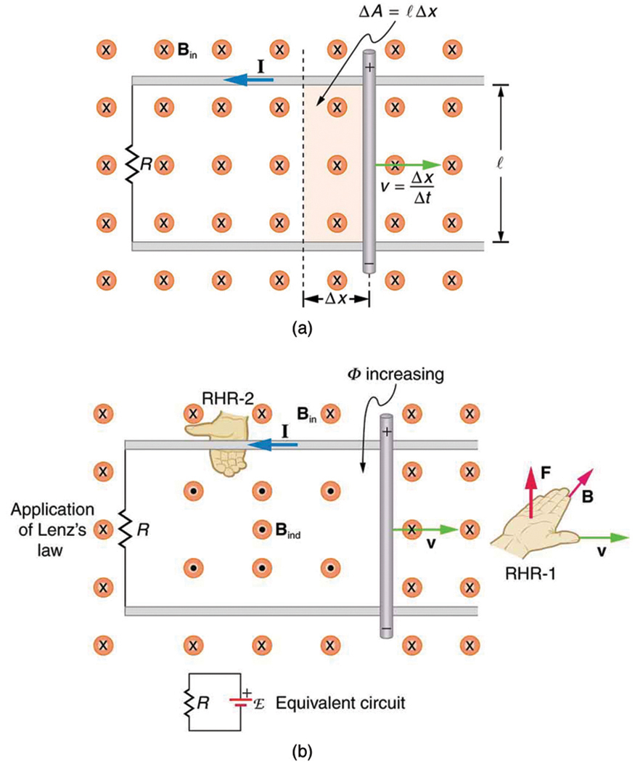
Induction, AC Circuits, and Electrical Technolo...
Motional EMF
(a) A motional emf=Bℓv is induced between the rails when this rod moves to the right in the uniform magnetic field. The magnetic field B is into the page, perpendicular to the moving rod and rails and, hence, to the area enclosed by them. (b) Lenz's law gives the directions of the induced field and current, and the polarity of the induced emf. Since the flux is increasing, the induced field is in the opposite direction, or out of the page. Right hand rule gives the current direction shown, and the polarity of the rod will drive such a current.
Free to share, print, make copies and changes. Get yours at www.boundless.com
OpenStax CNX. "OpenStax College, Motional Emf. February 7, 2013." CC BY 3.0 http://cnx.org/content/m42400/latest/ View on Boundless.com

Slide 19
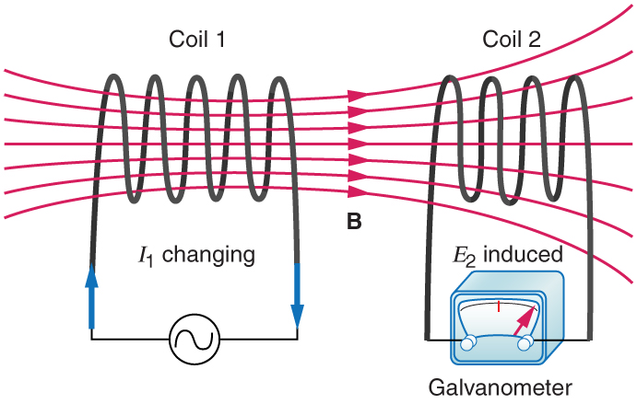
Induction, AC Circuits, and Electrical Technolo...
Mutual Inductance in Coils
These coils can induce emfs in one another like an inefficient transformer. Their mutual inductance M indicates the effectiveness of the coupling between them. Here a change in current in coil 1 is seen to induce an emf in coil 2. (Note that "E2 induced" represents the induced emf in coil 2. )
Free to share, print, make copies and changes. Get yours at www.boundless.com
OpenStax CNX. "OpenStax College, College Physics. January 8, 2013." CC BY 3.0 http://cnx.org/content/m42420/latest/?collection=col11406/1.7 View on Boundless.com

Slide 20
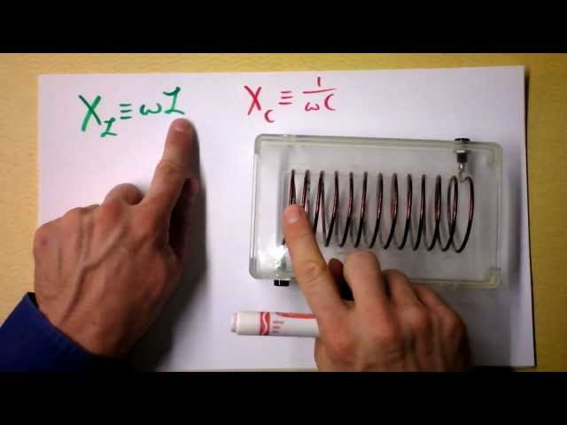
Induction, AC Circuits, and Electrical Technolo...
Phasors for Inductors in AC Circuits
Free to share, print, make copies and changes. Get yours at www.boundless.com
View on Boundless.com

Slide 21
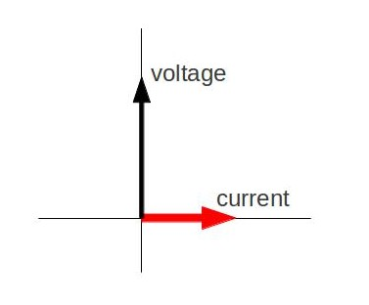
Induction, AC Circuits, and Electrical Technolo...
Phasor Diagram
Phasor diagram for an AC circuit with an inductor.
Free to share, print, make copies and changes. Get yours at www.boundless.com
Amazon Web Services. "Boundless." CC BY http://s3.amazonaws.com/figures.boundless.com/510ad330e4b0c14bf464a066/2.jpg View on Boundless.com

Slide 22
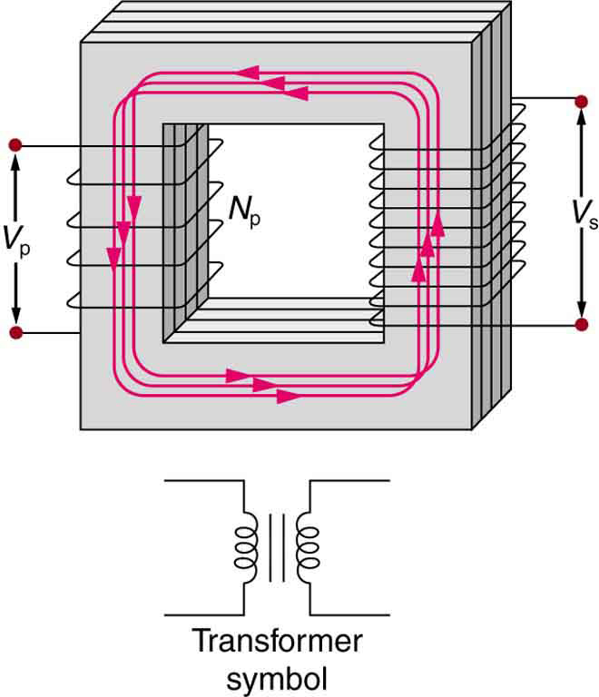
Induction, AC Circuits, and Electrical Technolo...
Simple Transformer
A typical construction of a simple transformer has two coils wound on a ferromagnetic core that is laminated to minimize eddy currents. The magnetic field created by the primary is mostly confined to and increased by the core, which transmits it to the secondary coil. Any change in current in the primary induces a current in the secondary.The figure shows a simple transformer with two coils wound on either sides of a laminated ferromagnetic core. The set of coil on left side of the core is marked as the primary and there number is given as N p. The voltage across the primary is given by V p. The set of coil on right side of the core is marked as the secondary and there number is represented as N s. The voltage across the secondary is given by V s. A symbol of the transformer is also shown below the diagram. It consists of two inductor coils separated by two equal parallel lines representing the core.
Free to share, print, make copies and changes. Get yours at www.boundless.com
OpenStax CNX. "OpenStax College, Transformers. February 8, 2013." CC BY 3.0 http://cnx.org/content/m42414/latest/ View on Boundless.com

Slide 23
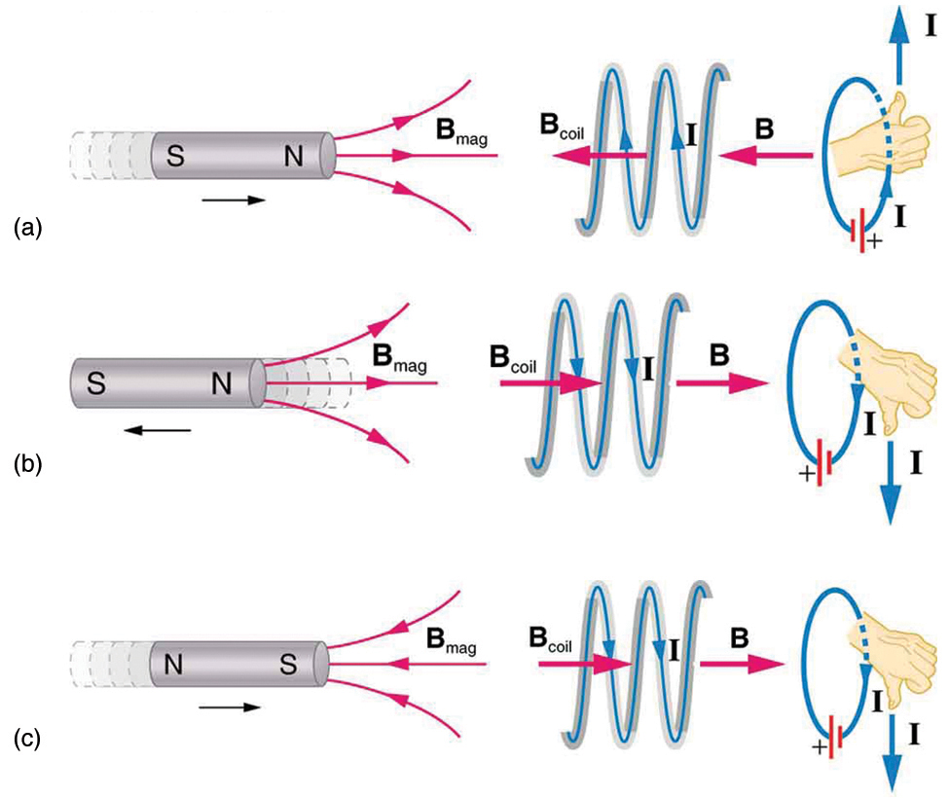
Induction, AC Circuits, and Electrical Technolo...
Lenz' Law
(a) When this bar magnet is thrust into the coil, the strength of the magnetic field increases in the coil. The current induced in the coil creates another field, in the opposite direction of the bar magnet's to oppose the increase. This is one aspect of Lenz's law—induction opposes any change in flux. (b) and (c) are two other situations. Verify for yourself that the direction of the induced Bcoil shown indeed opposes the change in flux and that the current direction shown is consistent with the right hand rule.
Free to share, print, make copies and changes. Get yours at www.boundless.com
OpenStax CNX. "OpenStax College, Faraday’s Law of Induction: Lenz’s Law. February 7, 2013." CC BY 3.0 http://cnx.org/content/m42392/latest/ View on Boundless.com

Slide 24
Induction, AC Circuits, and Electrical Technolo...
Magnetic Field Created By A Solenoid
Magnetic field created by a solenoid (cross-sectional view) described using field lines. Energy is "stored" in the magnetic field.
Free to share, print, make copies and changes. Get yours at www.boundless.com
Wikipedia. "Solenoid." CC BY http://en.wikipedia.org/wiki/Solenoid View on Boundless.com

Slide 25
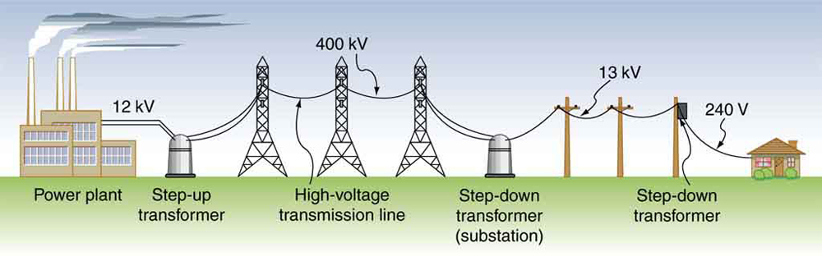
Induction, AC Circuits, and Electrical Technolo...
Transformer Setup
Transformers change voltages at several points in a power distribution system. Electric power is usually generated at greater than 10 kV, and transmitted long distances at voltages over 200 kV—sometimes as great as 700 kV—to limit energy losses. Local power distribution to neighborhoods or industries goes through a substation and is sent short distances at voltages ranging from 5 to 13 kV. This is reduced to 120, 240, or 480 V for safety at the individual user site.
Free to share, print, make copies and changes. Get yours at www.boundless.com
OpenStax CNX. "OpenStax College, Transformers. February 8, 2013." CC BY 3.0 http://cnx.org/content/m42414/latest/ View on Boundless.com

Slide 26
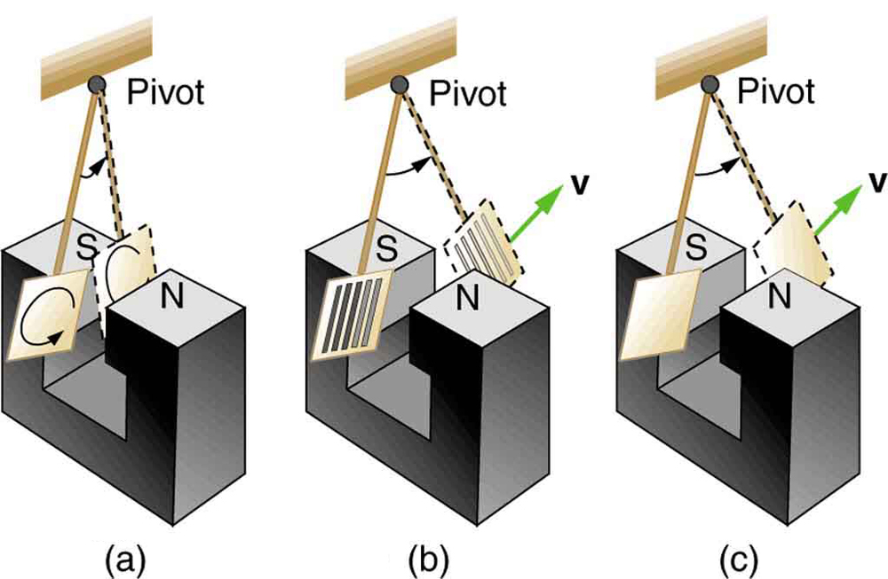
Induction, AC Circuits, and Electrical Technolo...
Device for Exploring Eddy Currents and Magnetic Damping
A common physics demonstration device for exploring eddy currents and magnetic damping. (a) The motion of a metal pendulum bob swinging between the poles of a magnet is quickly damped by the action of eddy currents. (b) There is little effect on the motion of a slotted metal bob, implying that eddy currents are made less effective. (c) There is also no magnetic damping on a nonconducting bob, since the eddy currents are extremely small.
Free to share, print, make copies and changes. Get yours at www.boundless.com
OpenStax CNX. "OpenStax College, Eddy Currents and Magnetic Damping. February 8, 2013." CC BY 3.0 http://cnx.org/content/m42404/latest/ View on Boundless.com

Slide 27
Induction, AC Circuits, and Electrical Technolo...
Inductor Symbol
Free to share, print, make copies and changes. Get yours at www.boundless.com
OpenStax CNX. "OpenStax College, College Physics. January 8, 2013." CC BY 3.0 http://cnx.org/content/m42420/latest/?collection=col11406/1.7 View on Boundless.com

Slide 28
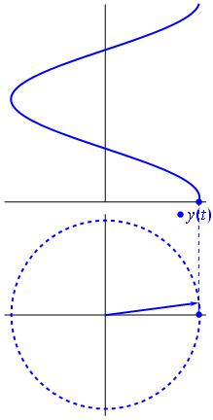
Induction, AC Circuits, and Electrical Technolo...
Fig 3
A phasor can be seen as a vector rotating about the origin in a complex plane. The cosine function is the projection of the vector onto the real axis. Its amplitude is the modulus of the vector, and its argument is the total phase \omega t+\theta. The phase constant \theta represents the angle that the vector forms with the real axis at t = 0.
Free to share, print, make copies and changes. Get yours at www.boundless.com
Wikipedia. "Phasor." CC BY http://en.wikipedia.org/wiki/Phasor View on Boundless.com

Slide 29
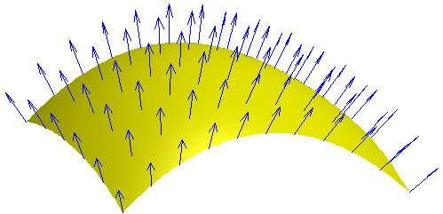
Induction, AC Circuits, and Electrical Technolo...
Varying Magnetic Field
Each point on a surface is associated with a direction, called the surface normal; the magnetic flux through a point is then the component of the magnetic field along this normal direction.
Free to share, print, make copies and changes. Get yours at www.boundless.com
Wikipedia. "Magnetic flux." CC BY http://en.wikipedia.org/wiki/Magnetic_flux View on Boundless.com

Slide 30
Induction, AC Circuits, and Electrical Technolo...
Faraday's Apparatus
This is Faraday's apparatus for demonstrating that a magnetic field can produce a current. A change in the field produced by the top coil induces an EMF and, hence, a current in the bottom coil. When the switch is opened and closed, the galvanometer registers currents in opposite directions. No current flows through the galvanometer when the switch remains closed or open.
Free to share, print, make copies and changes. Get yours at www.boundless.com
OpenStax CNX. "OpenStax College, Induced Emf and Magnetic Flux. February 7, 2013." CC BY 3.0 http://cnx.org/content/m42390/latest/ View on Boundless.com

Slide 31
Induction, AC Circuits, and Electrical Technolo...
A simple, modern speaker.
A speaker with magnet and coils that is used to produce sound.
Free to share, print, make copies and changes. Get yours at www.boundless.com
Wikipedia. "SpkFrontCutawayView." CC BY-SA http://en.wikipedia.org/wiki/File:SpkFrontCutawayView.svg View on Boundless.com

Slide 32
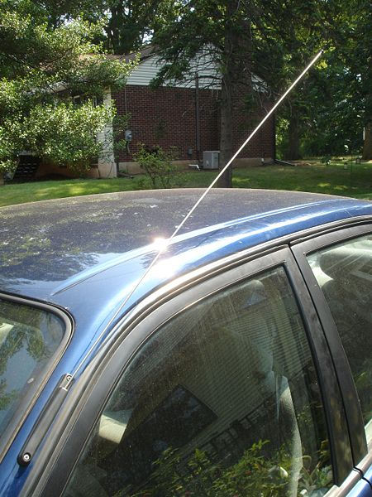
Induction, AC Circuits, and Electrical Technolo...
Car Antenna
A common car antenna that converts electric power in the air into electromagnetic waves.
Free to share, print, make copies and changes. Get yours at www.boundless.com
Wikipedia. "Antenna (radio)." GNU FDL http://en.wikipedia.org/wiki/Antenna_(radio) View on Boundless.com

Slide 33
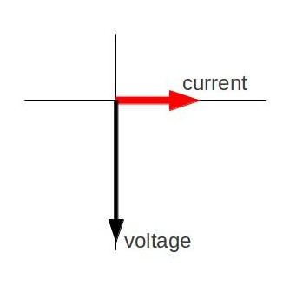
Induction, AC Circuits, and Electrical Technolo...
Fig 4
Phasor diagram for an AC circuit with a capacitor
Free to share, print, make copies and changes. Get yours at www.boundless.com
Amazon Web Services. "Boundless." CC BY http://s3.amazonaws.com/figures.boundless.com/510acb88e4b0f11e4bcb056e/1.jpg View on Boundless.com

Slide 34
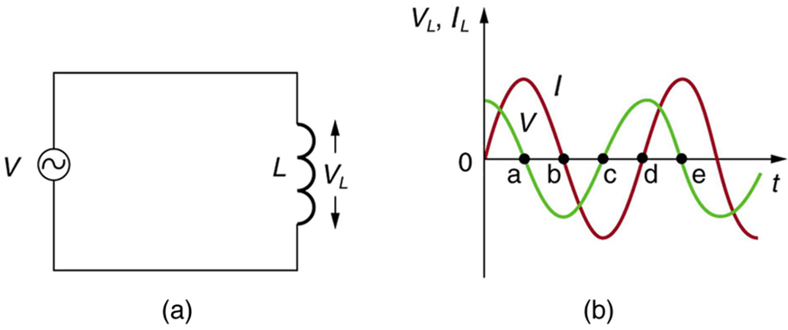
Induction, AC Circuits, and Electrical Technolo...
AC Voltage Source in Series with an Inductor
(a) An AC voltage source in series with an inductor having negligible resistance. (b) Graph of current and voltage across the inductor as functions of time.
Free to share, print, make copies and changes. Get yours at www.boundless.com
OpenStax CNX. "OpenStax College, College Physics. January 31, 2013." CC BY 3.0 http://cnx.org/content/m42427/latest/?collection=col11406/1.7 View on Boundless.com

Slide 35
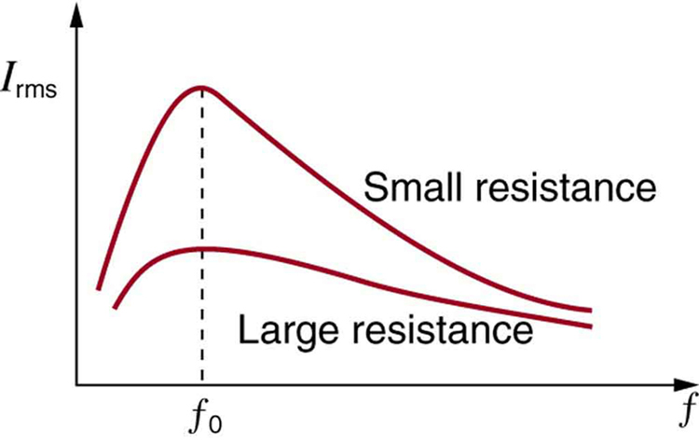
Induction, AC Circuits, and Electrical Technolo...
Current vs. Frequency
A graph of current versus frequency for two RLC series circuits differing only in the amount of resistance. Both have a resonance at f0, but that for the higher resistance is lower and broader. The driving AC voltage source has a fixed amplitude V0.
Free to share, print, make copies and changes. Get yours at www.boundless.com
OpenStax CNX. "OpenStax College, RLC Series AC Circuits. January 31, 2013." CC BY 3.0 http://cnx.org/content/m42431/latest/ View on Boundless.com

Slide 36
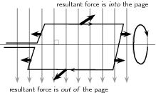
Induction, AC Circuits, and Electrical Technolo...
Torque
The force on opposite sides of the coil will be in opposite directions because the charges are moving in opposite directions. This means the coil will rotate.
Free to share, print, make copies and changes. Get yours at www.boundless.com
OpenStax CNX. "Free High School Science Texts Project, Electrodynamics: Generators and Motors. February 8, 2013." CC BY 3.0 http://cnx.org/content/m39508/latest/ View on Boundless.com

Slide 37
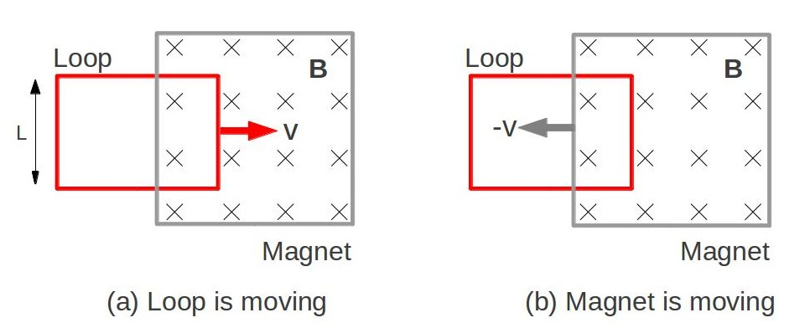
Induction, AC Circuits, and Electrical Technolo...
Conductor Loop Moving Into a Magnet
(a) Motional EMF. The current loop is moving into a stationary magnet. The direction of the magnetic field is into the screen. (b) Induced EMF. Current loop is stationary, and the magnet is moving.
Free to share, print, make copies and changes. Get yours at www.boundless.com
Amazon Web Services. "Boundless." CC BY http://s3.amazonaws.com/figures.boundless.com/51154f34e4b0c14bf464da40/1.jpg View on Boundless.com

Slide 38
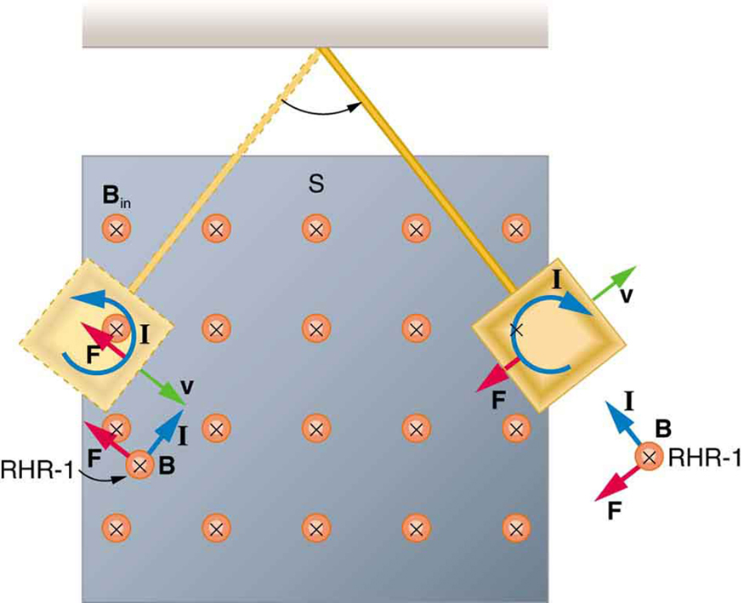
Induction, AC Circuits, and Electrical Technolo...
Conducting Plate Passing Between the Poles of a Magnet
A more detailed look at the conducting plate passing between the poles of a magnet. As it enters and leaves the field, the change in flux produces an eddy current. Magnetic force on the current loop opposes the motion. There is no current and no magnetic drag when the plate is completely inside the uniform field.
Free to share, print, make copies and changes. Get yours at www.boundless.com
OpenStax CNX. "OpenStax College, Eddy Currents and Magnetic Damping. February 8, 2013." CC BY 3.0 http://cnx.org/content/m42404/latest/ View on Boundless.com

Slide 39
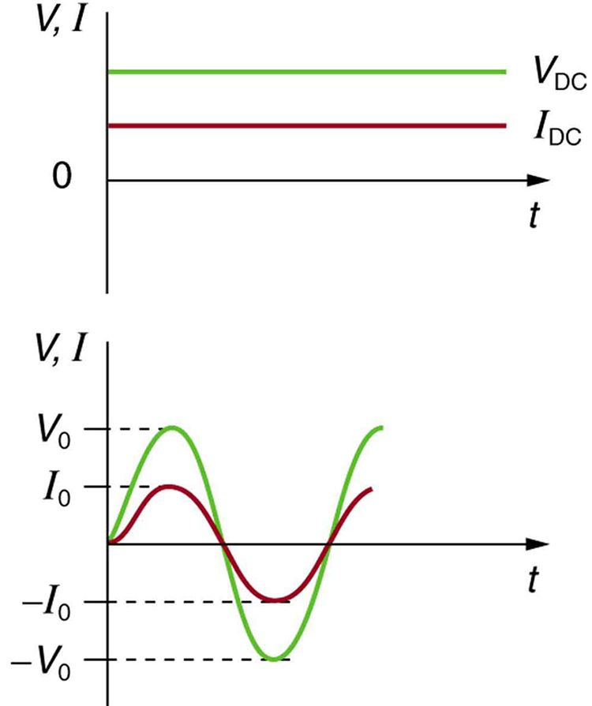
Induction, AC Circuits, and Electrical Technolo...
Sinusoidal Voltage and Current
(a) DC voltage and current are constant in time, once the current is established. (b) A graph of voltage and current versus time for 60-Hz AC power. The voltage and current are sinusoidal and are in phase for a simple resistance circuit. The frequencies and peak voltages of AC sources differ greatly.
Free to share, print, make copies and changes. Get yours at www.boundless.com
OpenStax CNX. "OpenStax College, College Physics. January 16, 2015." CC BY 3.0 http://cnx.org/content/m42348/latest/?collection=col11406/1.7 View on Boundless.com

Slide 40
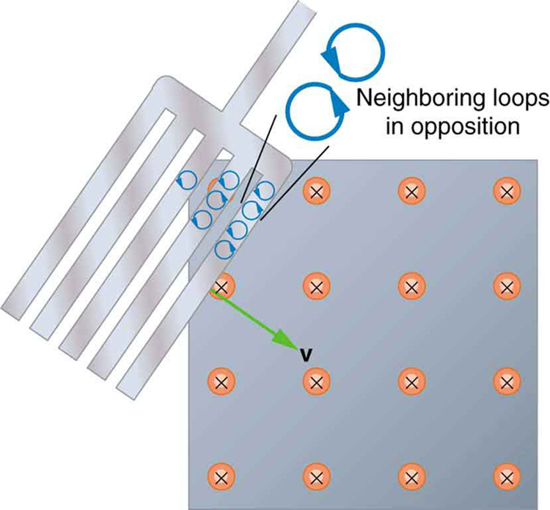
Induction, AC Circuits, and Electrical Technolo...
Eddy Currents Induced in a Slotted Metal Plate
Eddy currents induced in a slotted metal plate entering a magnetic field form small loops, and the forces on them tend to cancel, thereby making magnetic drag almost zero.
Free to share, print, make copies and changes. Get yours at www.boundless.com
OpenStax CNX. "OpenStax College, Eddy Currents and Magnetic Damping. February 8, 2013." CC BY 3.0 http://cnx.org/content/m42404/latest/ View on Boundless.com

Slide 41
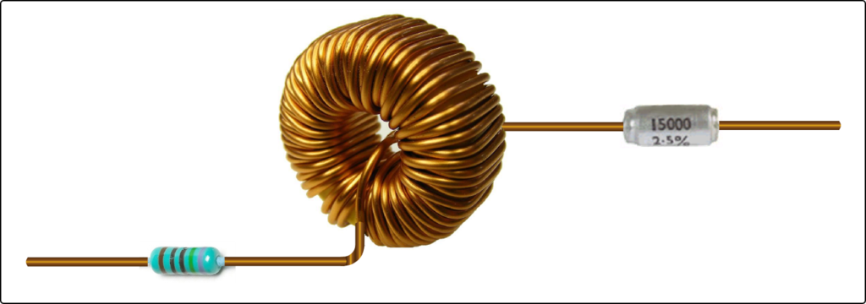
Induction, AC Circuits, and Electrical Technolo...
Series RLC Circuit
A series RLC circuit: a resistor, inductor and capacitor (from left).
Free to share, print, make copies and changes. Get yours at www.boundless.com
Wikipedia. "RLC circuit." CC BY http://en.wikipedia.org/wiki/RLC_circuit%23Laplace_domain View on Boundless.com

Slide 42
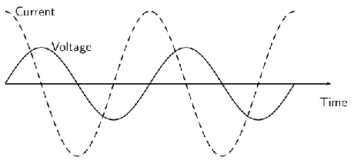
Induction, AC Circuits, and Electrical Technolo...
Fig 2
The current peaks (has its maximum) one quarter of a wave before the voltage when a capacitor is connected to an alternating voltage.
Free to share, print, make copies and changes. Get yours at www.boundless.com
OpenStax CNX. "Free High School Science Texts Project, Electronics: Capacitive and Inductive Circuits. January 31, 2013." CC BY 3.0 http://cnx.org/content/m39523/latest/ View on Boundless.com

Slide 43
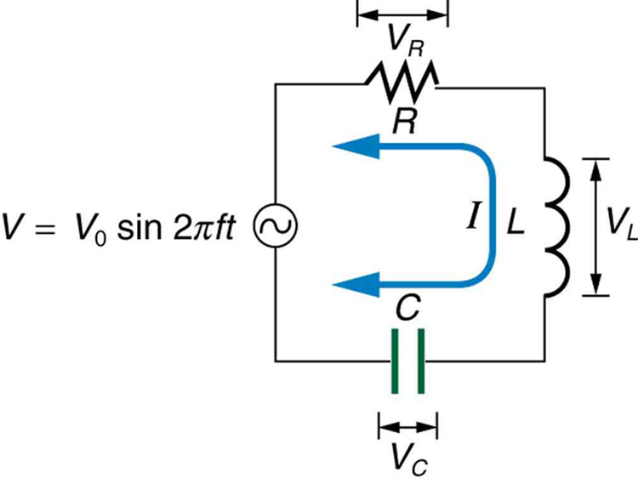
Induction, AC Circuits, and Electrical Technolo...
RLC Series Circuit
An RLC series circuit with an AC voltage source. f is the frequency of the source.
Free to share, print, make copies and changes. Get yours at www.boundless.com
OpenStax CNX. "OpenStax College, RLC Series AC Circuits. January 31, 2013." CC BY 3.0 http://cnx.org/content/m42431/latest/ View on Boundless.com

Slide 44
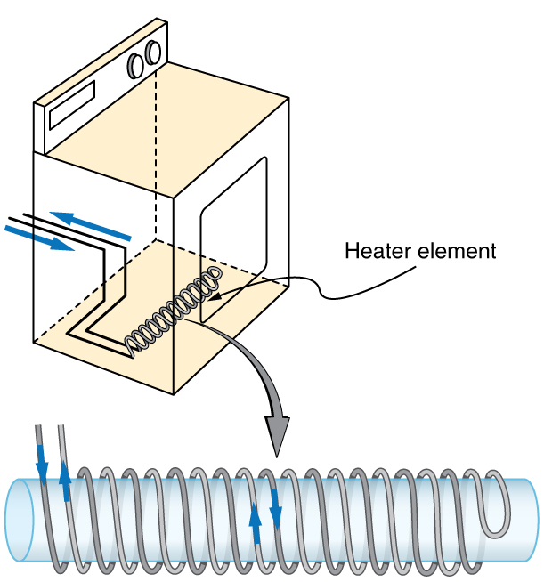
Induction, AC Circuits, and Electrical Technolo...
Counterwinding
The heating coils of an electric clothes dryer can be counter-wound so that their magnetic fields cancel one another, greatly reducing the mutual inductance with the case of the dryer.
Free to share, print, make copies and changes. Get yours at www.boundless.com
OpenStax CNX. "OpenStax College, College Physics. January 8, 2013." CC BY 3.0 http://cnx.org/content/m42420/latest/?collection=col11406/1.7 View on Boundless.com

Slide 45
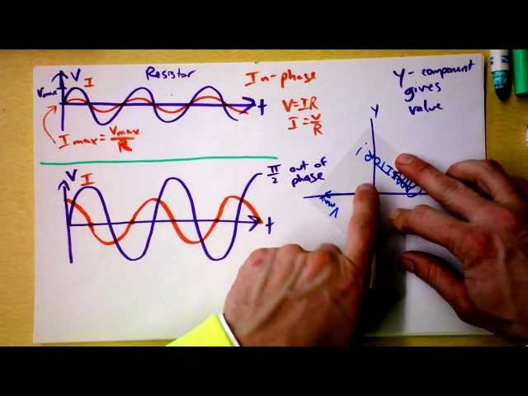
Induction, AC Circuits, and Electrical Technolo...
Capacitors in AC Circuits with Phasors
Free to share, print, make copies and changes. Get yours at www.boundless.com
View on Boundless.com

Slide 46
Induction, AC Circuits, and Electrical Technolo...
Mutual Inductance in Coils
These coils can induce emfs in one another like an inefficient transformer. Their mutual inductance M indicates the effectiveness of the coupling between them. Here a change in current in coil 1 is seen to induce an emf in coil 2. (Note that "E2 induced" represents the induced emf in coil 2. )
Free to share, print, make copies and changes. Get yours at www.boundless.com
OpenStax CNX. "OpenStax College, College Physics. January 16, 2015." CC BY 3.0 http://cnx.org/content/m42420/latest/?collection=col11406/1.7 View on Boundless.com

Slide 47
Induction, AC Circuits, and Electrical Technolo...
Magnetic Field Created By A Solenoid
Magnetic field created by a solenoid (cross-sectional view) described using field lines. Energy is "stored" in the magnetic field.
Free to share, print, make copies and changes. Get yours at www.boundless.com
Wikipedia. "Solenoid." CC BY http://en.wikipedia.org/wiki/Solenoid View on Boundless.com

Slide 48
Induction, AC Circuits, and Electrical Technolo...
Motional EMF
(a) A motional emf=Bℓv is induced between the rails when this rod moves to the right in the uniform magnetic field. The magnetic field B is into the page, perpendicular to the moving rod and rails and, hence, to the area enclosed by them. (b) Lenz's law gives the directions of the induced field and current, and the polarity of the induced emf. Since the flux is increasing, the induced field is in the opposite direction, or out of the page. Right hand rule gives the current direction shown, and the polarity of the rod will drive such a current.
Free to share, print, make copies and changes. Get yours at www.boundless.com
OpenStax CNX. "OpenStax College, Motional EMF. January 16, 2015." CC BY 3.0 http://cnx.org/content/m42400/latest/ View on Boundless.com

Slide 49
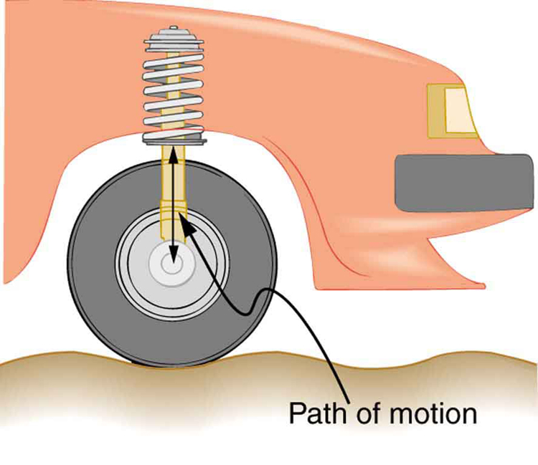
Induction, AC Circuits, and Electrical Technolo...
Forced Damped Motion of a Wheel on a Car Spring
The forced but damped motion of the wheel on the car spring is analogous to an RLC series AC circuit. The shock absorber damps the motion and dissipates energy, analogous to the resistance in an RLC circuit. The mass and spring determine the resonant frequency.
Free to share, print, make copies and changes. Get yours at www.boundless.com
OpenStax CNX. "OpenStax College, RLC Series AC Circuits. February 1, 2013." CC BY 3.0 http://cnx.org/content/m42431/latest/ View on Boundless.com

Slide 50
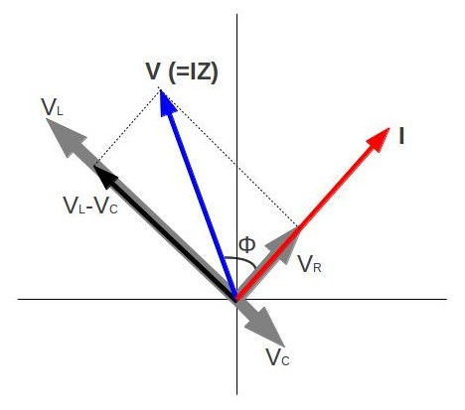
Induction, AC Circuits, and Electrical Technolo...
Phasor Diagram for an RLC Series Circuit
Phasor diagram for an RLC series circuit. \phi is the phase angle, equal to the phase difference between the voltage and current.
Free to share, print, make copies and changes. Get yours at www.boundless.com
Amazon Web Services. "Boundless." CC BY http://s3.amazonaws.com/figures.boundless.com/510b06ffe4b0c14bf464a30e/4.jpg View on Boundless.com

Slide 51
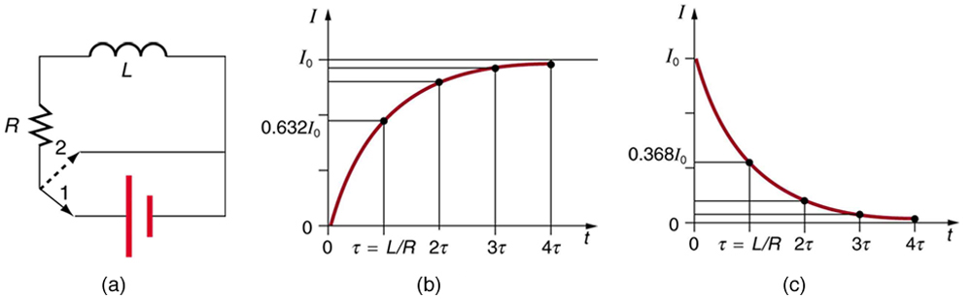
Induction, AC Circuits, and Electrical Technolo...
Current in an RL Circuit
(a) An RL circuit with a switch to turn current on and off. When in position 1, the battery, resistor, and inductor are in series and a current is established. In position 2, the battery is removed and the current eventually stops because of energy loss in the resistor. (b) A graph of current growth versus time when the switch is moved to position 1. (c) A graph of current decay when the switch is moved to position 2.
Free to share, print, make copies and changes. Get yours at www.boundless.com
OpenStax CNX. "OpenStax College, College Physics. January 25, 2013." CC BY 3.0 http://cnx.org/content/m42425/latest/?collection=col11406/1.7 View on Boundless.com

Slide 52
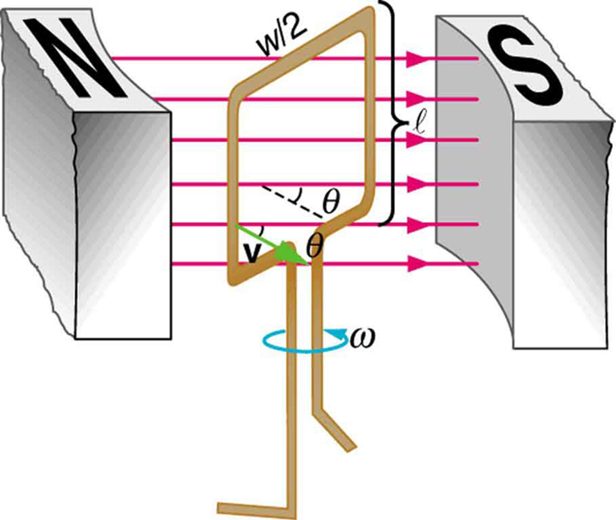
Induction, AC Circuits, and Electrical Technolo...
Diagram of an Electric Generator
A generator with a single rectangular coil rotated at constant angular velocity in a uniform magnetic field produces an emf that varies sinusoidally in time. Note the generator is similar to a motor, except the shaft is rotated to produce a current rather than the other way around.
Free to share, print, make copies and changes. Get yours at www.boundless.com
OpenStax CNX. "OpenStax College, Electric Generators. February 8, 2013." CC BY 3.0 http://cnx.org/content/m42408/latest/ View on Boundless.com

Slide 53
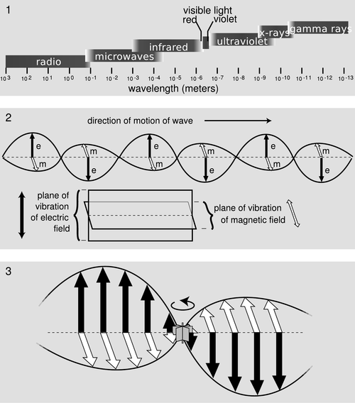
Induction, AC Circuits, and Electrical Technolo...
EM Wave
The propogation of an electromagnetic wave as predicted by Maxwell and confirmed by Hertz.
Free to share, print, make copies and changes. Get yours at www.boundless.com
Light and Matter. CC BY-SA http://www.lightandmatter.com/html_books/7cp/ch06/figs/emspectrum.png View on Boundless.com

Slide 54
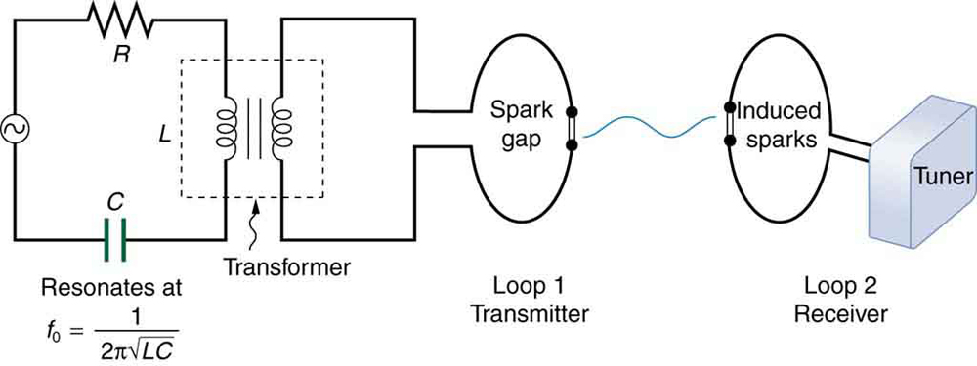
Induction, AC Circuits, and Electrical Technolo...
Apparatus Used by Hertz
The apparatus used by Hertz in 1887 to generate and detect electromagnetic waves. An RLC circuit connected to the first loop caused sparks across a gap in the wire loop and generated electromagnetic waves. Sparks across a gap in the second loop located across the laboratory gave evidence that the waves had been received.
Free to share, print, make copies and changes. Get yours at www.boundless.com
OpenStax CNX. "OpenStax College, Maxwell’s Equations: Electromagnetic Waves Predicted and Observed. March 1, 2013." CC BY 3.0 http://cnx.org/content/m42437/latest/Figure%2025_01_02a.jpg View on Boundless.com

Slide 55
Attribution
Induction, AC Circuits, and Electrical Technolo...
Boundless Learning. "Boundless." CC BY-SA 3.0 http://www.boundless.com//physics/definition/motional-emf
OpenStax CNX. "OpenStax College, College Physics. September 17, 2013." CC BY 3.0 http://cnx.org/content/m42400/latest/?collection=col11406/latest
Boundless Learning. "Boundless." CC BY-SA 3.0 http://www.boundless.com//physics/definition/faraday-s-law-of-induction--3
OpenStax CNX. "OpenStax College, Faraday’s Law of Induction: Lenz’s Law. September 17, 2013." CC BY 3.0 http://cnx.org/content/m42392/latest/
OpenStax CNX. "OpenStax College, RLC Series AC Circuits. September 17, 2013." CC BY 3.0 http://cnx.org/content/m42431/latest/
Wikipedia. "rms." CC BY-SA 3.0 http://en.wikipedia.org/wiki/rms
Wikipedia. "Antenna (radio)." CC BY-SA 3.0 http://en.wikipedia.org/wiki/Antenna_(radio)
Wiktionary. "transmitter." CC BY-SA 3.0 http://en.wiktionary.org/wiki/transmitter
Wiktionary. "wavelength." CC BY-SA 3.0 http://en.wiktionary.org/wiki/wavelength
Wiktionary. "frequency." CC BY-SA 3.0 http://en.wiktionary.org/wiki/frequency
Light and Matter. "Fields." CC BY-SA http://www.lightandmatter.com/html_books/7cp/ch06/ch06.html#Section6.2
Wiktionary. "transformer." CC BY-SA 3.0 http://en.wiktionary.org/wiki/transformer
Boundless Learning. "Boundless." CC BY-SA 3.0 http://www.boundless.com//physics/definition/faraday-s-law-of-induction--3
OpenStax CNX. "OpenStax College, Inductance. September 17, 2013." CC BY 3.0 http://cnx.org/content/m42420/latest/
Wiktionary. "Ohm's law." CC BY-SA 3.0 http://en.wiktionary.org/wiki/Ohm's_law
OpenStax CNX. "OpenStax College, College Physics. September 17, 2013." CC BY 3.0 http://cnx.org/content/m42348/latest/?collection=col11406/1.7
Wiktionary. "reactance." CC BY-SA 3.0 http://en.wiktionary.org/wiki/reactance
Free to share, print, make copies and changes. Get yours at www.boundless.com

Slide 56
Induction, AC Circuits, and Electrical Technolo...
Wikipedia. "Resonance." CC BY-SA 3.0 http://en.wikipedia.org/wiki/Resonance
Wiktionary. "impedance." CC BY-SA 3.0 http://en.wiktionary.org/wiki/impedance
OpenStax CNX. "OpenStax College, RLC Series AC Circuits. September 17, 2013." CC BY 3.0 http://cnx.org/content/m42431/latest/
Wikipedia. "rms." CC BY-SA 3.0 http://en.wikipedia.org/wiki/rms
Wikipedia. "Magnetic field." CC BY-SA 3.0 http://en.wikipedia.org/wiki/Magnetic_field%23Energy_stored_in_magnetic_fields
Wiktionary. "inductor." CC BY-SA 3.0 http://en.wiktionary.org/wiki/inductor
Wiktionary. "permeability." CC BY-SA 3.0 http://en.wiktionary.org/wiki/permeability
OpenStax CNX. "OpenStax College, Inductance. September 17, 2013." CC BY 3.0 http://cnx.org/content/m42420/latest/
Wikipedia. "ferromagnet." CC BY-SA 3.0 http://en.wikipedia.org/wiki/ferromagnet
Wikipedia. "Microphone." CC BY-SA 3.0 http://en.wikipedia.org/wiki/Microphone
Wikipedia. "Seismograph." CC BY-SA 3.0 http://en.wikipedia.org/wiki/Seismograph
Wikipedia. "Primary memory." CC BY-SA 3.0 http://en.wikipedia.org/wiki/Primary_memory%23Primary_storage
Wikipedia. "Loudspeaker." CC BY-SA 3.0 http://en.wikipedia.org/wiki/Loudspeaker
Wikipedia. "GFCI." CC BY-SA 3.0 http://en.wikipedia.org/wiki/GFCI
Wiktionary. "amplifier." CC BY-SA 3.0 http://en.wiktionary.org/wiki/amplifier
Wiktionary. "magnetic field." CC BY-SA 3.0 http://en.wiktionary.org/wiki/magnetic_field
Wiktionary. "special relativity." CC BY-SA 3.0 http://en.wiktionary.org/wiki/special_relativity
Wiktionary. "frame of reference." CC BY-SA 3.0 http://en.wiktionary.org/wiki/frame_of_reference
OpenStax CNX. "OpenStax College, College Physics. September 17, 2013." CC BY 3.0 http://cnx.org/content/m42400/latest/?collection=col11406/latest
Free to share, print, make copies and changes. Get yours at www.boundless.com

Slide 57
Induction, AC Circuits, and Electrical Technolo...
OpenStax CNX. "OpenStax College, The Hall Effect. September 17, 2013." CC BY 3.0 http://cnx.org/content/m42377/latest/
Wikipedia. "Inductor." CC BY-SA 3.0 http://en.wikipedia.org/wiki/Inductor
Wikipedia. "Inductor." CC BY-SA 3.0 http://en.wikipedia.org/wiki/Inductor
Wiktionary. "inductor." CC BY-SA 3.0 http://en.wiktionary.org/wiki/inductor
Light and Matter. "Fields." CC BY-SA http://www.lightandmatter.com/html_books/7cp/ch06/ch06.html#Section6.2
Wikipedia. "Maxwell's equations." CC BY-SA 3.0 http://en.wikipedia.org/wiki/Maxwell's%20equations
Wikipedia. "vector area." CC BY-SA 3.0 http://en.wikipedia.org/wiki/vector%20area
Wikipedia. "Stokes' theorem." CC BY-SA 3.0 http://en.wikipedia.org/wiki/Stokes'%20theorem
OpenStax CNX. "Paul Padley, Faraday's Law. September 17, 2013." CC BY 3.0 http://cnx.org/content/m12869/latest/
Wikipedia. "Rl circuit." CC BY-SA 3.0 http://en.wikipedia.org/wiki/Rl_circuit
Wiktionary. "inductor." CC BY-SA 3.0 http://en.wiktionary.org/wiki/inductor
Boundless Learning. "Boundless." CC BY-SA 3.0 http://www.boundless.com//physics/definition/characteristic-time-constant
OpenStax CNX. "OpenStax College, College Physics. September 17, 2013." CC BY 3.0 http://cnx.org/content/m42425/latest/?collection=col11406/1.7
OpenStax CNX. "OpenStax College, College Physics. September 17, 2013." CC BY 3.0 http://cnx.org/content/m42420/latest/?collection=col11406/1.7
Wiktionary. "torque." CC BY-SA 3.0 http://en.wiktionary.org/wiki/torque
Wiktionary. "Lorentz force." CC BY-SA 3.0 http://en.wiktionary.org/wiki/Lorentz_force
OpenStax CNX. "Free High School Science Texts Project, Electrodynamics: Generators and Motors. September 17, 2013." CC BY 3.0 http://cnx.org/content/m39508/latest/
Wikipedia. "electromotive force." CC BY-SA 3.0 http://en.wikipedia.org/wiki/electromotive%20force
Wikipedia. "Electric generator." CC BY-SA 3.0 http://en.wikipedia.org/wiki/Electric_generator
Free to share, print, make copies and changes. Get yours at www.boundless.com

Slide 58
Induction, AC Circuits, and Electrical Technolo...
Wiktionary. "turbine." CC BY-SA 3.0 http://en.wiktionary.org/wiki/turbine
OpenStax CNX. "OpenStax College, Electric Generators. September 17, 2013." CC BY 3.0 http://cnx.org/content/m42408/latest/
Wikipedia. "electromotive force." CC BY-SA 3.0 http://en.wikipedia.org/wiki/electromotive%20force
Wiktionary. "magnetic flux." CC BY-SA 3.0 http://en.wiktionary.org/wiki/magnetic_flux
Wiktionary. "induction." CC BY-SA 3.0 http://en.wiktionary.org/wiki/induction
OpenStax CNX. "OpenStax College, Motional Emf. September 17, 2013." CC BY 3.0 http://cnx.org/content/m42400/latest/
Wikipedia. "Phasor." CC BY-SA 3.0 http://en.wikipedia.org/wiki/Phasor
Wikipedia. "rms." CC BY-SA 3.0 http://en.wikipedia.org/wiki/rms
OpenStax CNX. "Free High School Science Texts Project, Electronics: Capacitive and Inductive Circuits. September 17, 2013." CC BY 3.0 http://cnx.org/content/m39523/latest/
OpenStax CNX. "OpenStax College, College Physics. September 17, 2013." CC BY 3.0 http://cnx.org/content/m42427/latest/?collection=col11406/1.7
Wiktionary. "phasor." CC BY-SA 3.0 http://en.wiktionary.org/wiki/phasor
Wiktionary. "Lenz's law." CC BY-SA 3.0 http://en.wiktionary.org/wiki/Lenz's_law
Wikipedia. "rms." CC BY-SA 3.0 http://en.wikipedia.org/wiki/rms
OpenStax CNX. "OpenStax College, College Physics. September 17, 2013." CC BY 3.0 http://cnx.org/content/m42427/latest/?collection=col11406/1.7
Wiktionary. "resonance." CC BY-SA 3.0 http://en.wiktionary.org/wiki/resonance
OpenStax CNX. "OpenStax College, RLC Series AC Circuits. September 17, 2013." CC BY 3.0 http://cnx.org/content/m42431/latest/
Wiktionary. "Lenz's law." CC BY-SA 3.0 http://en.wiktionary.org/wiki/Lenz's_law
Wikipedia. "rms." CC BY-SA 3.0 http://en.wikipedia.org/wiki/rms
Wikipedia. "vector area." CC BY-SA 3.0 http://en.wikipedia.org/wiki/vector%20area
Free to share, print, make copies and changes. Get yours at www.boundless.com

Slide 59
Induction, AC Circuits, and Electrical Technolo...
Boundless Learning. "Boundless." CC BY-SA 3.0 http://www.boundless.com//physics/definition/galvanometer
OpenStax CNX. "OpenStax College, Induced Emf and Magnetic Flux. September 17, 2013." CC BY 3.0 http://cnx.org/content/m42390/latest/
Wikipedia. "Magnetic flux." CC BY-SA 3.0 http://en.wikipedia.org/wiki/Magnetic_flux
Wiktionary. "magnetic flux." CC BY-SA 3.0 http://en.wiktionary.org/wiki/magnetic_flux
OpenStax CNX. "OpenStax College, Transformers. September 17, 2013." CC BY 3.0 http://cnx.org/content/m42414/latest/
Boundless Learning. "Boundless." CC BY-SA 3.0 http://www.boundless.com//physics/definition/faraday-s-law-of-induction--3
OpenStax CNX. "OpenStax College, College Physics. September 17, 2013." CC BY 3.0 http://cnx.org/content/m42437/latest/?collection=col11406/latest
Wikipedia. "electromotive force." CC BY-SA 3.0 http://en.wikipedia.org/wiki/electromotive%20force
Wiktionary. "magnetic field." CC BY-SA 3.0 http://en.wiktionary.org/wiki/magnetic+field
Wiktionary. "electric field." CC BY-SA 3.0 http://en.wiktionary.org/wiki/electric+field
OpenStax CNX. "OpenStax College, College Physics. September 17, 2013." CC BY 3.0 http://cnx.org/content/m42437/latest/?collection=col11406/latest
Wikipedia. "Faraday's law of induction." CC BY-SA 3.0 http://en.wikipedia.org/wiki/Faraday's_law_of_induction
Wikipedia. "electromotive force." CC BY-SA 3.0 http://en.wikipedia.org/wiki/electromotive%20force
Wiktionary. "flux." CC BY-SA 3.0 http://en.wiktionary.org/wiki/flux
Wiktionary. "solenoid." CC BY-SA 3.0 http://en.wiktionary.org/wiki/solenoid
OpenStax CNX. "OpenStax College, Faraday’s Law of Induction: Lenz’s Law. September 17, 2013." CC BY 3.0 http://cnx.org/content/m42392/latest/
Wikipedia. "electromotive force." CC BY-SA 3.0 http://en.wikipedia.org/wiki/electromotive%20force
OpenStax CNX. "OpenStax College, Eddy Currents and Magnetic Damping. September 17, 2013." CC BY 3.0 http://cnx.org/content/m42404/latest/
Boundless Learning. "Boundless." CC BY-SA 3.0 http://www.boundless.com//physics/definition/faraday-s-law-of-induction--3
Free to share, print, make copies and changes. Get yours at www.boundless.com

Slide 60
Induction, AC Circuits, and Electrical Technolo...
OpenStax CNX. "OpenStax College, Back Emf. September 17, 2013." CC BY 3.0 http://cnx.org/content/m42411/latest/
Wikipedia. "Inductance." CC BY-SA 3.0 http://en.wikipedia.org/wiki/Inductance
Wiktionary. "mutual inductance." CC BY-SA 3.0 http://en.wiktionary.org/wiki/mutual_inductance
Wiktionary. "inductor." CC BY-SA 3.0 http://en.wiktionary.org/wiki/inductor
Boundless Learning. "Boundless." CC BY-SA 3.0 http://www.boundless.com//physics/definition/self-inductance--2
OpenStax CNX. "OpenStax College, College Physics. September 18, 2013." CC BY 3.0 http://cnx.org/content/m42420/latest/?collection=col11406/1.7
Free to share, print, make copies and changes. Get yours at www.boundless.com

